Slide 1
Refactoring

Slide 2
Objectives
To introduce refactoring
To understand the importance of refactoring
To give some refactoring examples

Slide 3
What is Refactoring?
“Refactoring is the art of improving the design of existing code. Refactoring provides us with ways to recognize problematic code and gives us recipes for improving it.” [William C. Wake]
“A change to the system that leaves its behavior unchanged, but enhances some non-functional quality - simplicity, flexibility, understandability, ...” [Kent Beck]
“The process of changing a software system in such a way that it does not alter the external behavior of the code, yet improves its internal structure” [Fowler]

Slide 4
What is Refactoring? (Cont’d)
Refactoring is about cleaning up the code after it has been written
Refactoring targets are potential problem areas (“bad smells in code”) in the design so far
Refactoring integrates very well with the agile development, but it can (and should) be used with other processes

Slide 5
Why Refactoring?
To improve the software design
  Makes the program easier to change
To make the software easier to understand
  Write for people, not the compiler
  Understand unfamiliar code
To help find bugs
  Refactor while debugging to clarify the code

Slide 6
Should We Refactor?
Some argue that good design does not lead to code needing refactoring but:
  Extremely difficult to get the design right the first time
  You cannot fully understand the problem domain
  You cannot understand user requirements, if he does!
  You cannot really plan how the system will evolve in five years
  Original design is often inadequate

Slide 7
Refactoring Examples
Extract Method
Replace Temp with Query
Introduce Explaining Variable
Replace Data Value with Object
Replace Array with Object
Replace Magic Number with Symbolic Constant
Replace Subclass with Fields
Decompose Conditional
Consolidate Duplicate Conditional Fragments

Slide 8
Refactoring Examples (Cont’d)
Rename Method
Separate Query from Modifier
Parameterize Method
Preserve Whole Object
Introduce Parameter Object
Replace Inheritance with Delegation
Replace Delegation with Inheritance
…

Slide 9
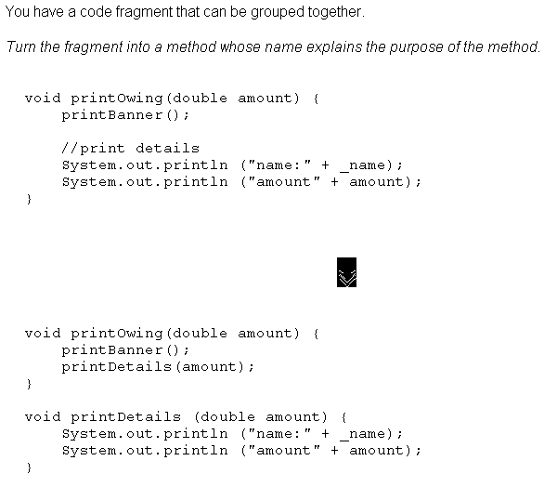
Extract Method

Slide 10
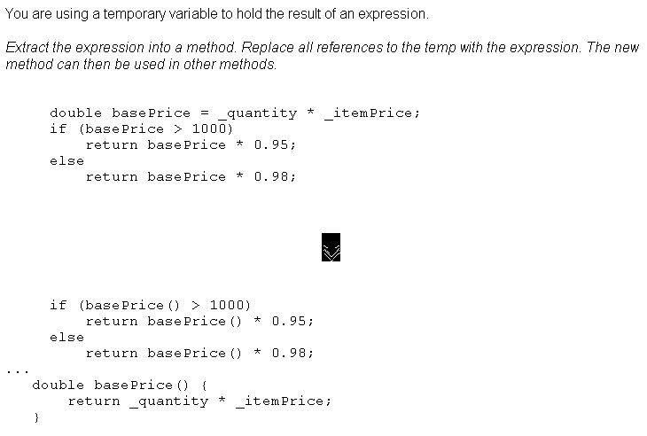
Replace Temp with Query

Slide 11
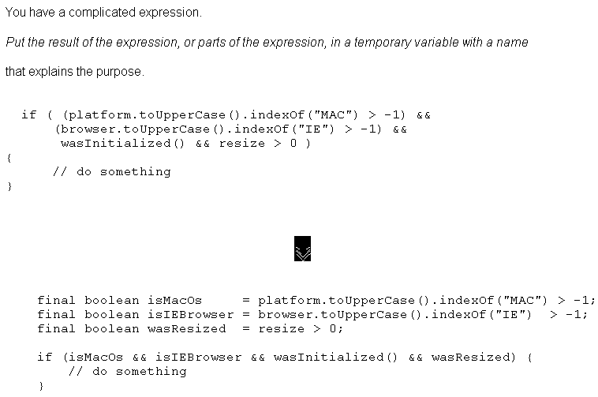
Introduce Explaining Variable

Slide 12
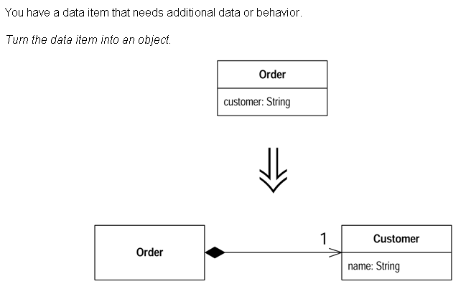
Replace Data Value with Object

Slide 13
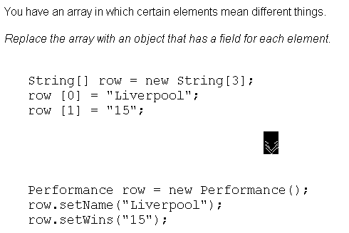
Replace Array with Object

Slide 14
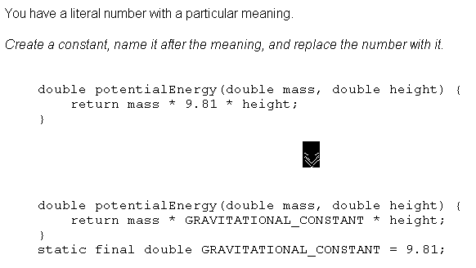
Replace Magic Number with Symbolic Constant

Slide 15
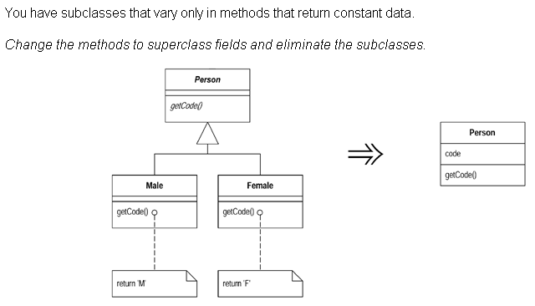
Replace Subclass with Fields

Slide 16
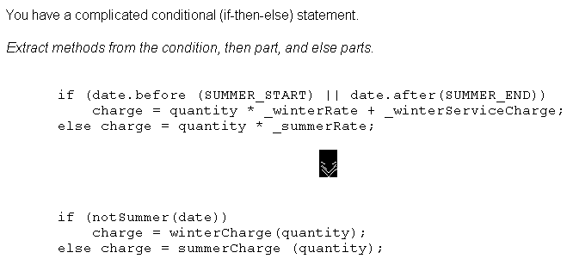
Decompose Conditional

Slide 17
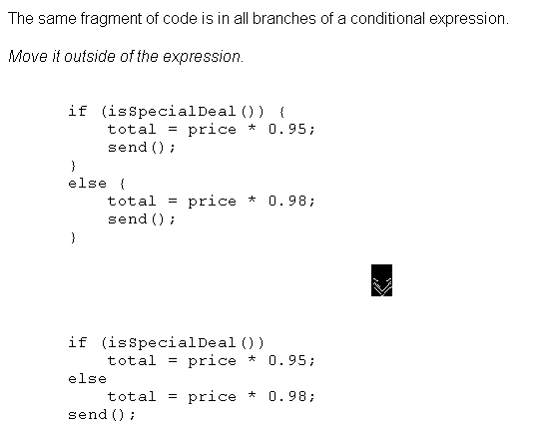
Consolidate Duplicate Conditional Fragments

Slide 18
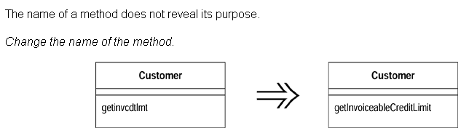
Rename Method

Slide 19
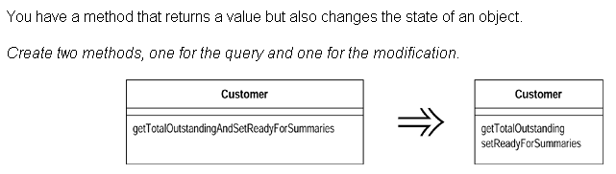
Separate Query from Modifier

Slide 20
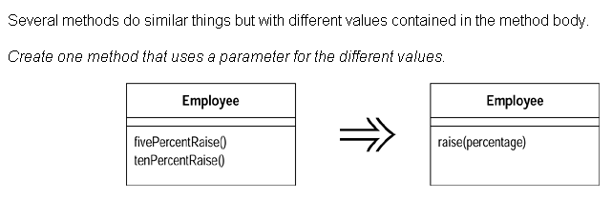
Parameterize Method

Slide 21
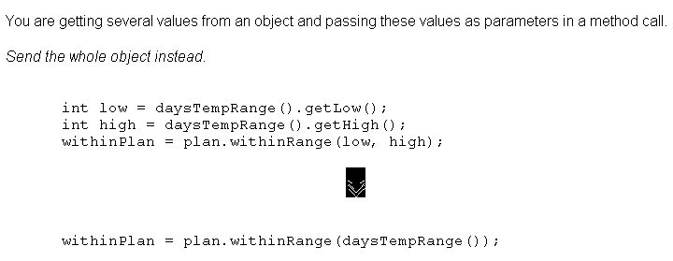
Preserve Whole Object

Slide 22
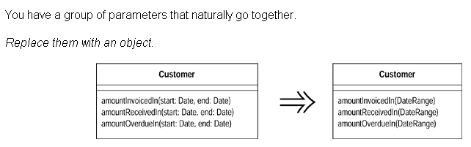
Introduce Parameter Object

Slide 23
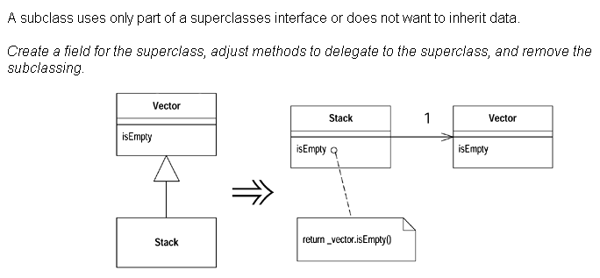
Replace Inheritance with Delegation

Slide 24
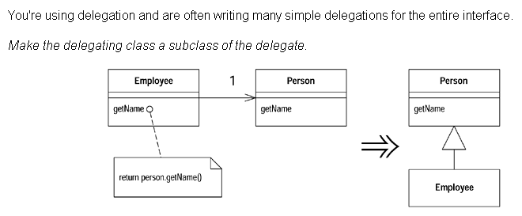
Replace Delegation with Inheritance

Slide 25
Some Obstacles to Refactoring
Complexity
  Changing design is hard
  Understanding code is hard
Possibility to introduce errors
  Run tests if possible
  Build tests
Cultural Issues
  “We pay you to add new features, not to improve the code!”
Performance issue
  Refactoring may slow down the execution
Development is always under time pressure
  Refactoring takes time
  Refactoring better after delivery

Slide 26
Why Are Developers Reluctant to Refactor Their Programs?
The programmers might not understand how to refactor.
If the benefits are long-term, why exert the effort now? In the long term, you might not be with the project to reap the benefits.
Refactoring code is an overhead activity; programmers are paid to write new features.
Refactoring might break the existing program.

Slide 27
Summary
“The process of changing a software system in such a way that it does not alter the external behavior of the code, yet improves its internal structure” [Fowler]
Refactor to:
  Improve the software design
  Make the software easier to understand
  Help find bugs
A catalog of refactoring exists: Extract Method, Replace Temp with Query, Decompose Conditional, etc…
Refactoring has some obstacles

